Slide 1
GSA Reverse Industry Training
July 10, 2017
Debriefs – Forecast for Today: Unpredictable with a Chance of Vague

Slide 2
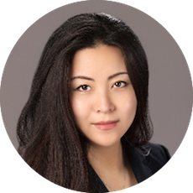
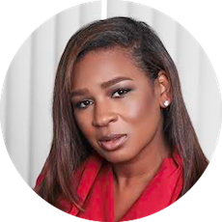
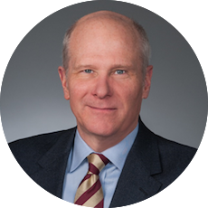
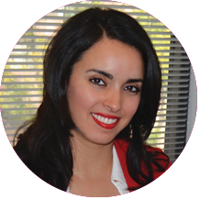
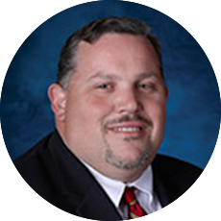
Industry Representatives
Elizabeth El-Nattar (M)
TRI-COR Industries, Inc. (TCI)
CEO
e.el-nattar@tricorind.com
Moderator
Denita Conway (S)
Proven Management, LLC
President & CEO
denita.conway@provenmgmt.com
Panelist
Mike McHugh (L)
GDIT
Staff Vice President
mike.mchugh@gdit.com
Panelist
Amina Elgouacem (S)
NEOSTEK, Inc.
President & CEO
amina.elgouacem@neostek.com
Panelist
John Roman (L)
LMI
Vice President
jroman@lmi.org
Panelist

Slide 3
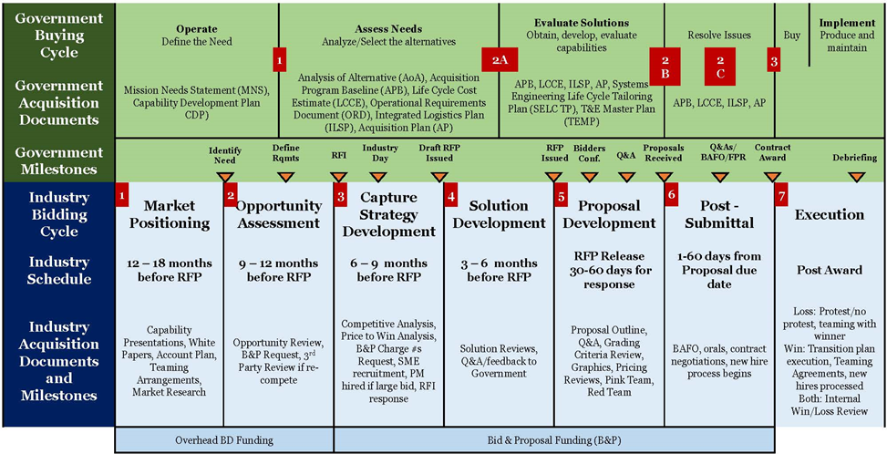
Acquisition Lifecycle Costs Incurred by Government and Industry Partners
An expensive lifecycle that warrants an effective closing event – The Debriefing
Costs Incurred by Government
Interest Decision
Pursuit Decision
Preliminary Bid Decision
Bid Decision Validation
Proposal Submittal
FPR Submittal
Decision Gates
Blue Team #1
Blue Team #2
Pink Team #2
Green Team
Color Team Reviews
Red Team
White Hat
Black Hat
Pink Team #1
Gold Team
3
Costs Incurred by Industry(4-5%)
B&P Cost (1.5-2%)
* As Defined by Association of Proposal Management Professionals / Shipley Associates

Slide 4
Debriefs – Forecast for Today: Unpredictable with a Chance of Vague
What Information are We Looking for?
What is the Industry’s Debriefing process?
How does Debriefing Quality Impact Bidder Protest?
Bi-Directional Debriefing?

Slide 5
Open Discussion / Questions
Email questions to reverseindustrytraining@gsa.gov

